Slide 1



ABAP on Hana s/4 Hana Training
Day 13
contact@anubhavtrainings.com

Slide 2

Agenda – Day 13
Comparison Between CDS v/s DDIC View
Making Virtual Data Model’s (VDM )
Basic/Interface View
Composite View
Consumption View
Describing CDS Annotations
Object Model Annotations
OData Annotations
Analytical Annotations
End User Annotations
UI Annotations
Consume CDS by Analytical tools

Slide 3
Comparison of CDS v/s DDIC Views
Comparison | CDS Views | Traditional Views
Code push down | Yes | No
Complexity | Yes | No
Outer Join and Unions | Yes | No
Complex Expressions like Case | Yes | No
Analytic Adoption (SAC, S/4HANA Embedded) | Yes | No
Ready-to-use Content by SAP | Yes | No
Extensions | Yes | No
OData Support | Direct | No (Manual – SEGW)
Type Definition | Yes | No
Metadata Extension and Annotation | Yes | No
Built-in Function | Yes | No
Parameter | Yes | No
Ready-made system variable | $session Yes | No

Slide 4



Virtual Data Model ( VDM )
Customers and Partners can develop on released VDM views
VDM is the data model and source for all types of applications
Transactional
Analytical
External interfaces
VDM is a set of views on SAP S/4HANA application data
Business-oriented
Understandable & semantically rich
Reusable & stable
Executed on SAP HANA
Implemented as ABAP CDS views (core data services)
R
R
R
Virtual Data Model (CDS)
SalesOrder
Customer
SalesOrderItem
Material
HANA Platform
SAP S/4HANA Core Tables (ECC)
>40 000 Tables (technical, cryptic, unrelated)

Slide 5
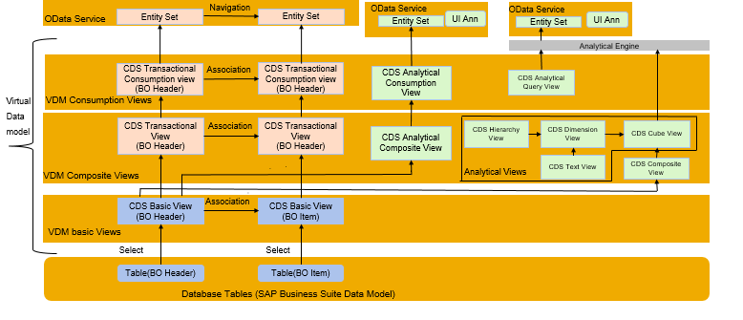
VDM Layering Architecture

Slide 6
Best Practice to build/use CDS in S/4HANA
Develop in a way that its sustainable.
Adopt industry standards.
Maintenance and handovers are easy.
VDM – Virtual Data Modeling, This is the concept we use to build CDS view using Layered Approach in SAP S/4HANA. VDM is an annotation and best practice.
You need to follow the proper nami-convension.
You need to develop modular way.
Use property annotations for VDM.
Use view type depending on kind of data you process.
VDM Views
Private Views
P_
Interface Views
I_
Consumption Views
C_
Developed for usage within the team, technically other should not use.
Embedded, API, SAC, Fiori Apps
Basic
Composite
Combine Transaction and Master Data I_SalesorderItems
Pure master data I_Material

Slide 7




Type’s of VDM View
All types of consumers
VDM Consumption Views C_*
VDM External API Views A_*
Purpose-built for apps and APIs
VDM Composite Interface Views I_*
Convenience and special views for reuse
VDM Basic Interface Views I_*
Basic VDM for reuse
Application Data (Tables)
Cryptic, invisible

Slide 8
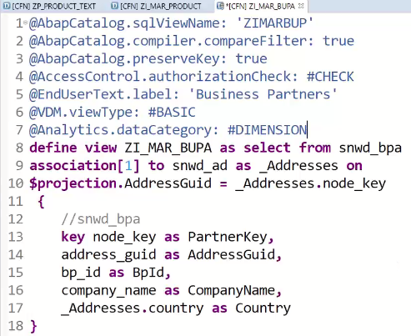
Annotations
Object Model Annotations
01
OData Annotations
02
03
Analytical
Annotations
04
End User Annotations
05
UI Annotations

Slide 9

Data Category Annotations
Annotate the data category as follows:
Plain transaction data as @Analytics.dataCategory: #FACT,
Transaction data containing all relevant fields for data aggregation as @Analytics.dataCategory: #CUBE,
Business documents, configuration and master data including keys and attributes as @Analytics.dataCategory: #DIMENSION,
Language-dependent texts as @ObjectModel.dataCategory: #TEXT,
Hierarchies as @ObjectModel.dataCategory: #HIERARCHY.

Slide 10

Consume CDS by Analytical Tools
Use Case:
We want to develop analytics for the business, where they can see the total sales in the system by per customer, per country and per product.
The end user should be able to slice and dice the data and also be able to arrange the columns and rows based on their need in an analytic report.
Exercise
Consume CDS by Analytics using VDM Concept

Slide 11

End of Day 13
Trainer: Anubhav Oberoy

Slide 12

Trainer: Anubhav Oberoy

Slide 13
THANK YOU
If you cannot do
great things, do small things in a great way.
Anubhav Oberoy
https://www.anubhavtrainings.com

Slide 14


We’re committed to empower you to be
Most Desirable Resource
through powerful training solutions.
We build the workforce of the future.
250+
Corporate Clients
30,000+
Learners Trained
25000+
Learners Placed
FREE WEBINARS
Sign up for free webinars with industry experts every fortnight!
Enroll Now!
Contact us today!
https://anubhavtrainings.com/

Slide 15




More from AnubhavTrainings.com

